Slide 1

IPL INSIGHT
2021-2023

Slide 2
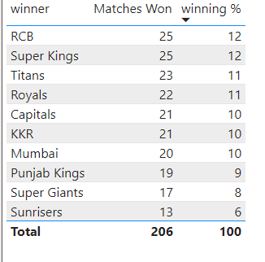
Teams based on past 3 years win count & winning %
RCB and Super Kings has the highest winning percentage -12%.

Slide 3
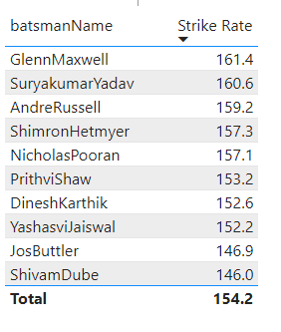
Top 10 batsmen based on past 3 years strike rate (min 60 balls faced in each season)

Slide 4
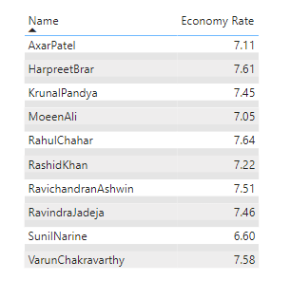
Top 10 bowlers based on past 3 years economy rate. (min 60 balls bowled in each season)

Slide 5
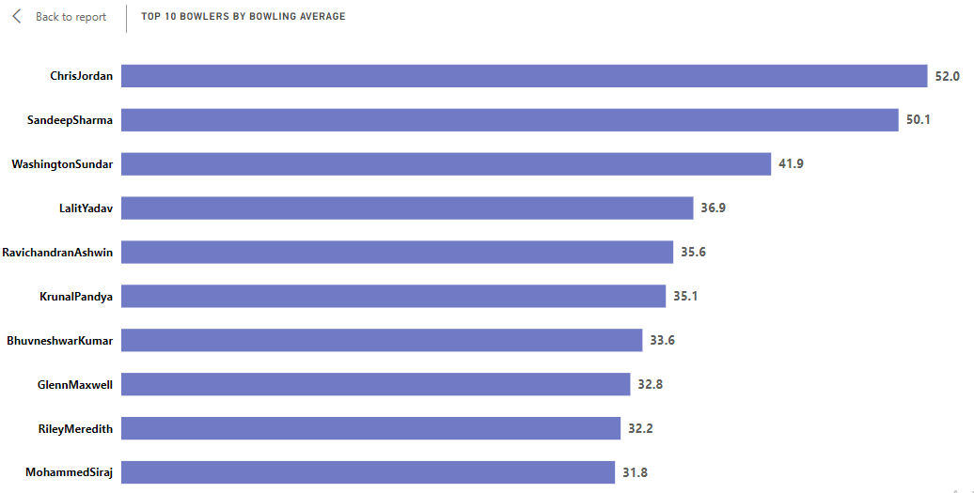
Top 10 bowlers based on past 3 years bowling average. (min 60 balls bowled in each season)

Slide 6
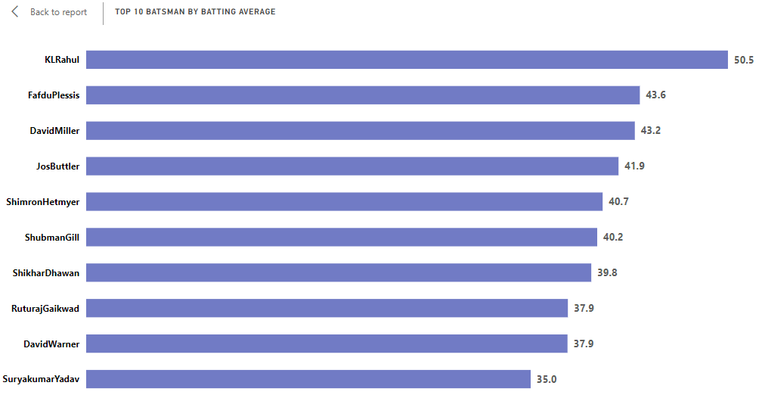
Top 10 batsmen based on past 3 years batting average. (min 60 balls faced in each season)

Slide 7
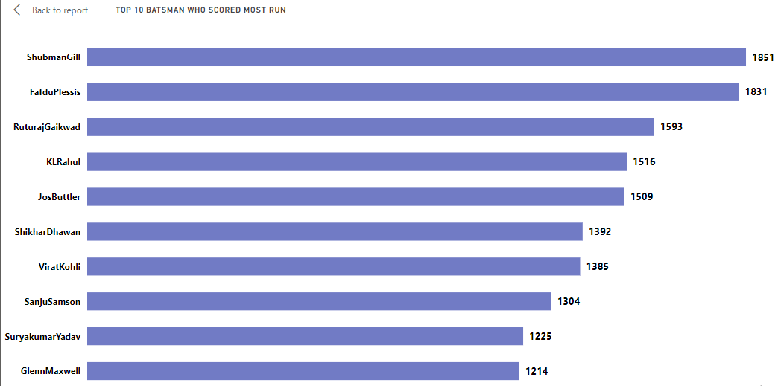
Top 10 batsmen based on past 3 years total runs scored.

Slide 8
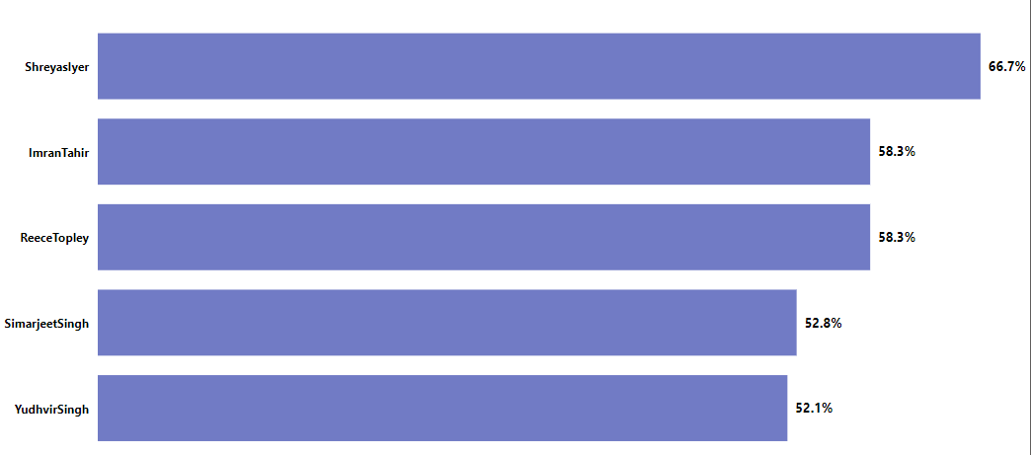
Top 5 bowlers based on past 3 years dot ball %.

Slide 9
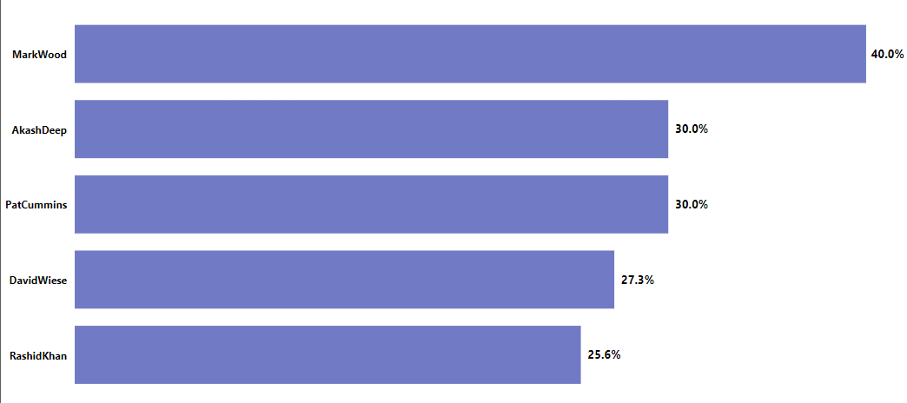
Top 5 batsmen based on past 3 years boundary % (fours and sixes)

Slide 10
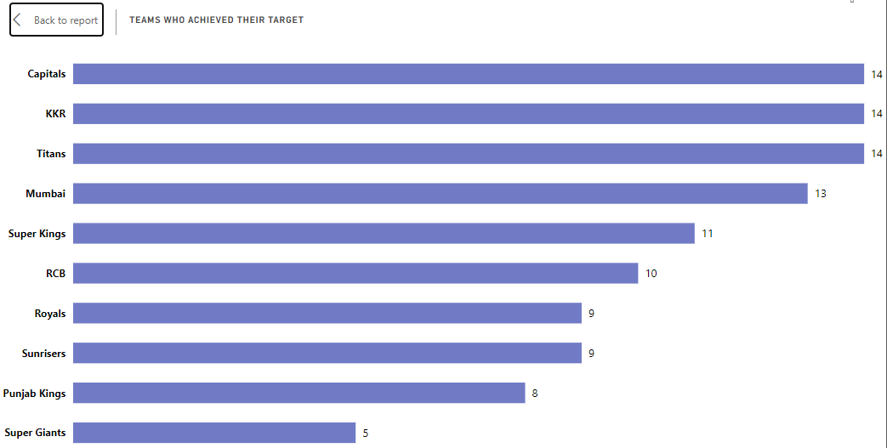
Teams with the number of wins achieved by chasing targets over the past 3 years.

Slide 11


Slide 12




Prediction for 2024 Top 4 qualifying teams

Slide 13
Prediction for 2024 Winner and Runner-Up Team

Slide 14
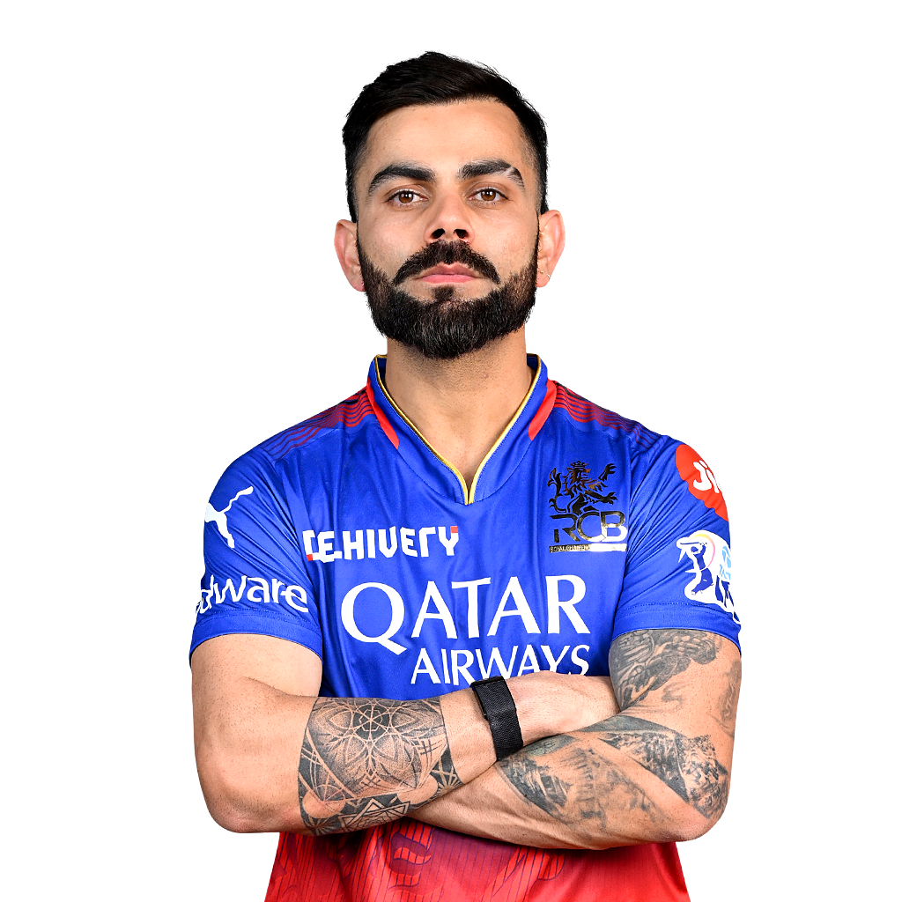

VIRAT KHOLI
YUZVENDRA CHAHAL
Prediction for 2024
Orange and purple cap player

Slide 15
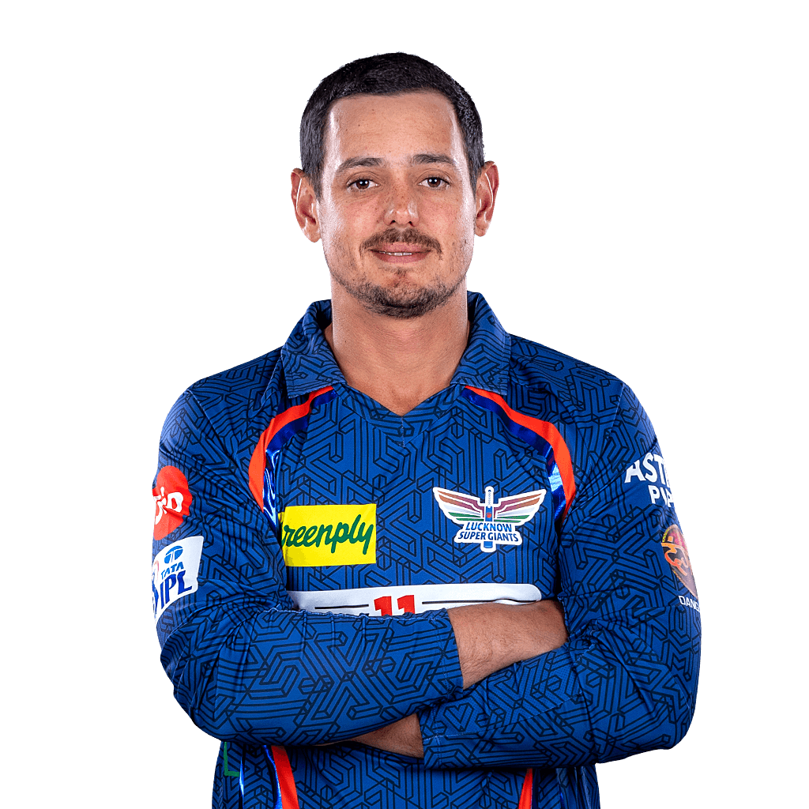
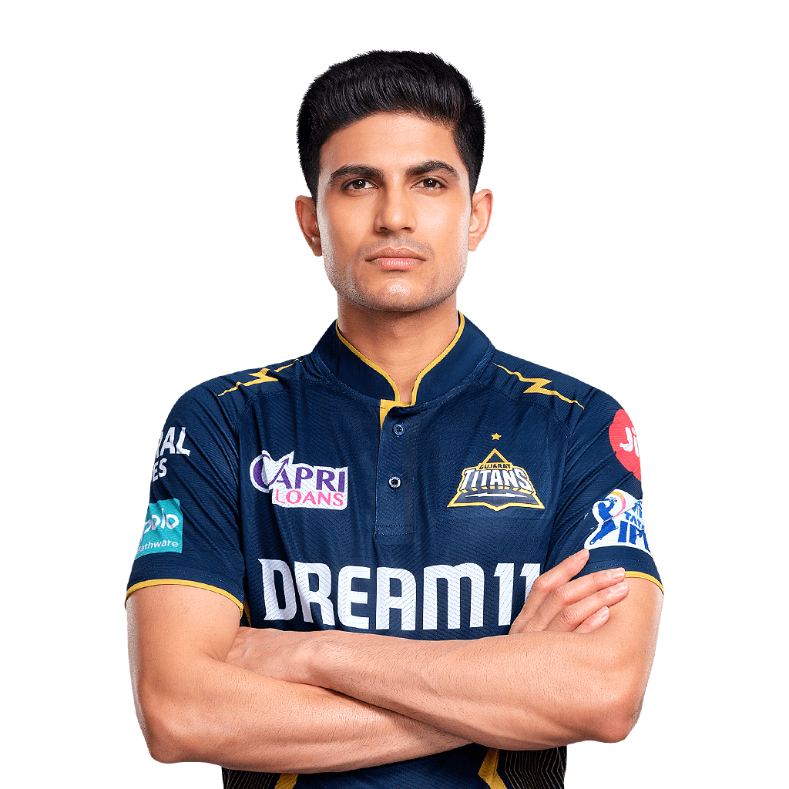

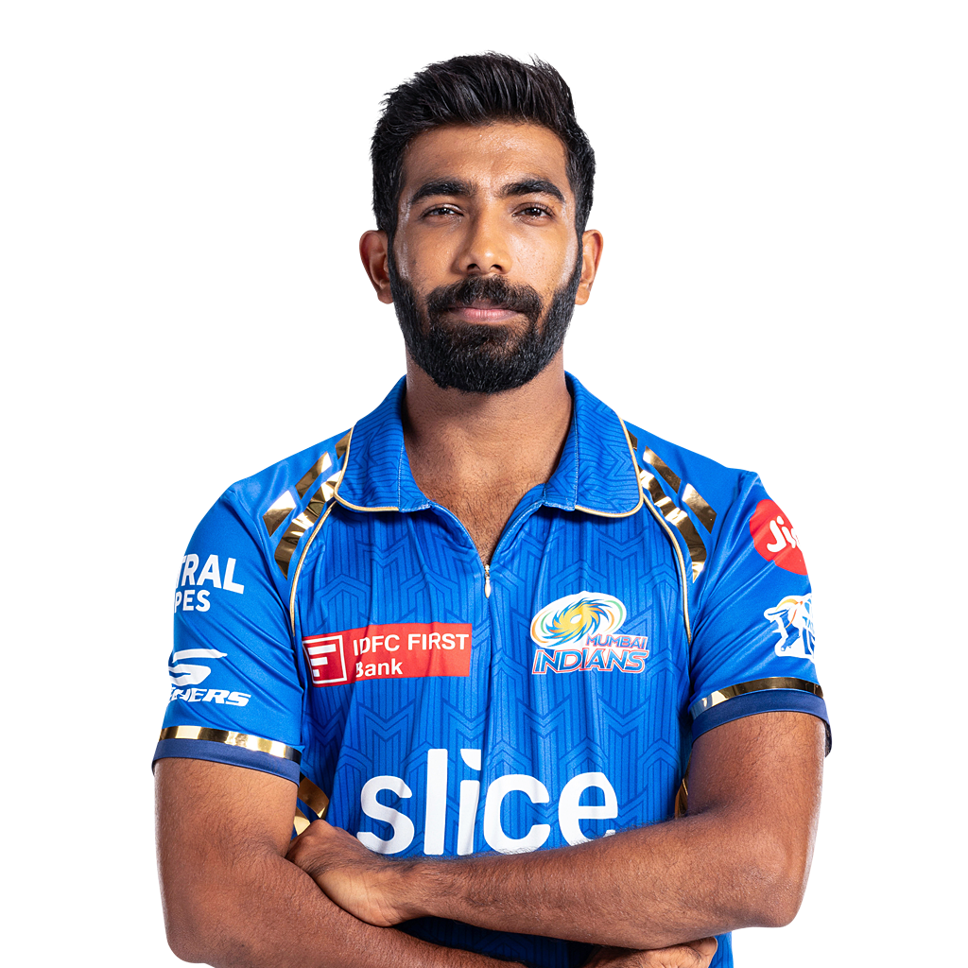
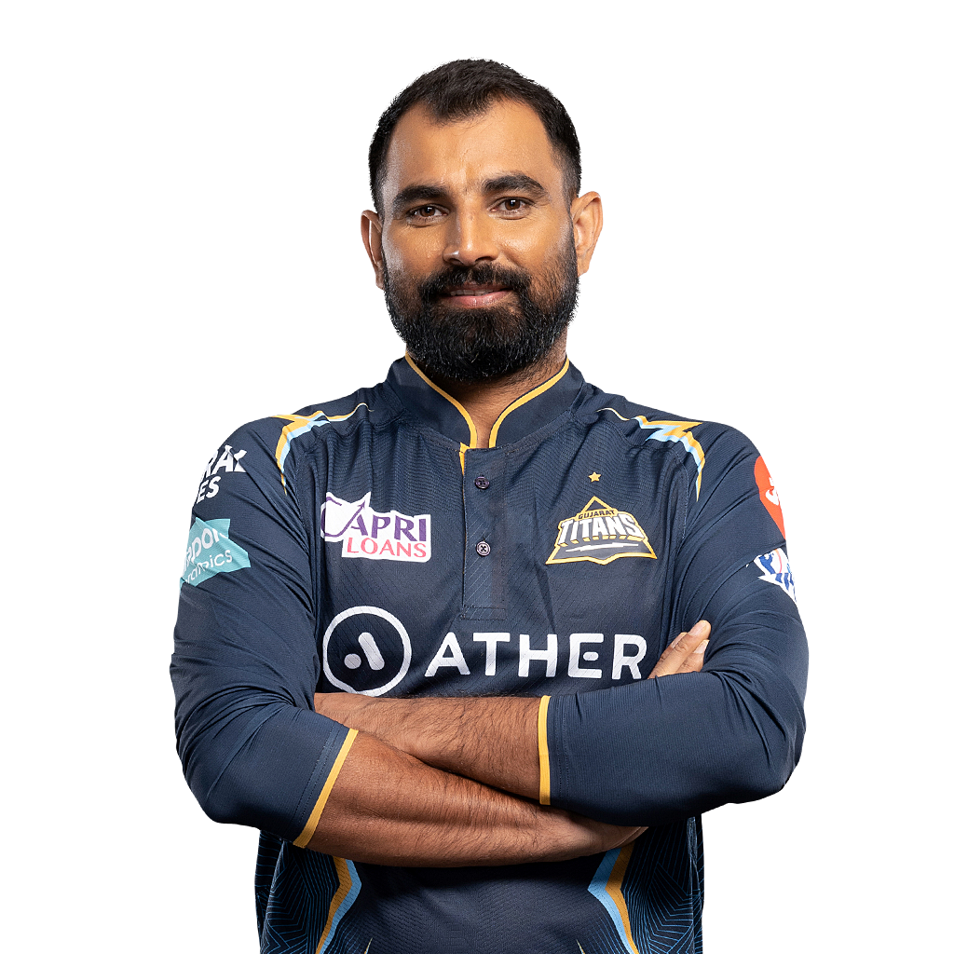
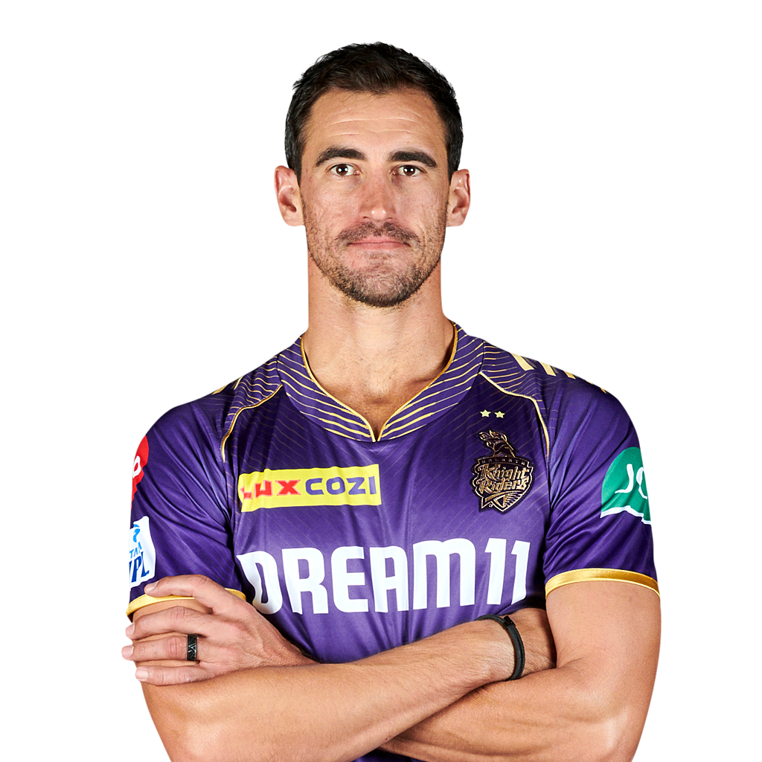


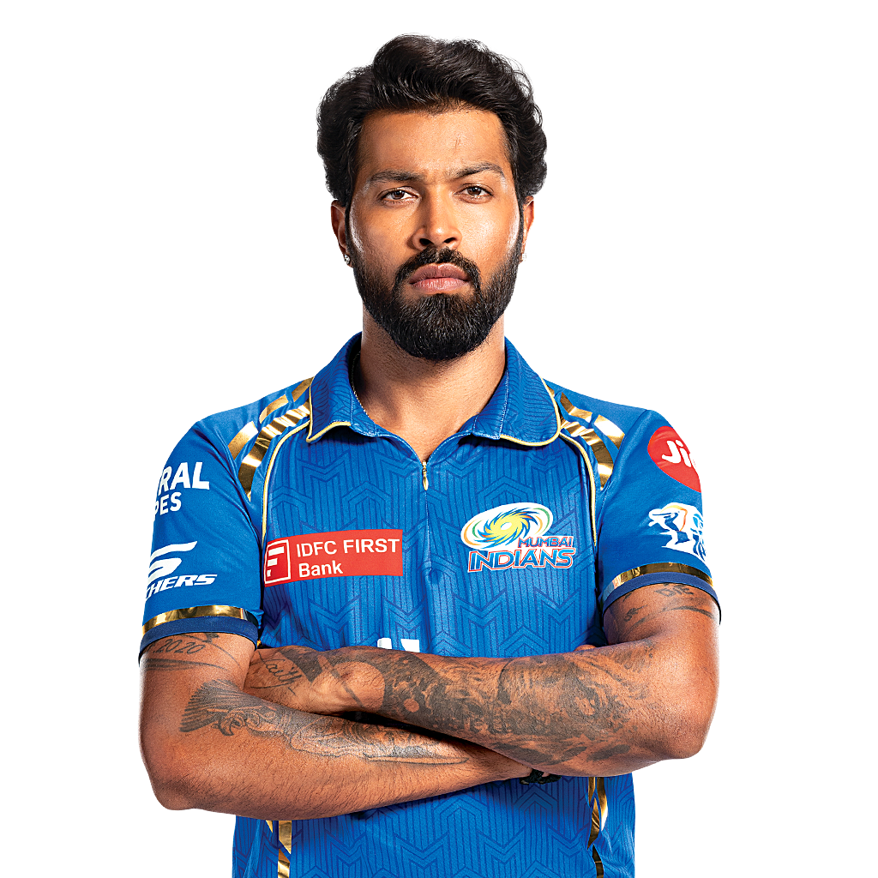
Pick your team selecting the Best 11 players based on their positions, 3 years performance data and additional research. Pick your top 3 all-rounders
WC Keeper
Quinton De
Kock
Batter
Virat Kholi
Shubham gill
Jos Butller
Bowler
Yuzvendra Chahal
Jasprit Bumrah
Mohammad Shami
Mitchell Starc
All Rounder
Gallen Maxwell
Ravindra Jadeja
Hardik Pandya

